Slide 1
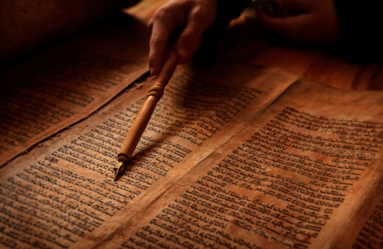
What Should We Do with the Old Testament?
Matthew 5:17-20
Dr. Rick Griffith, Crossroads International Church Singapore
BibleStudyDownloads.org

Slide 2
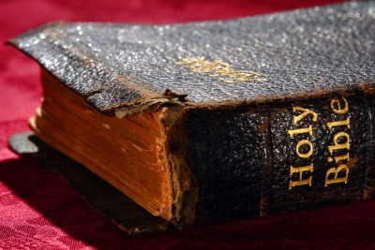
The Old Testament
Notes:
Many Christians neglect the Old Testament.

Slide 3
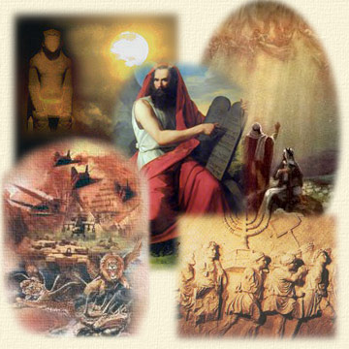
Old Testament Stories
Notes:
One lady told me she reads the whole Bible except Genesis and Revelation. She said she just get the point of the Genesis stories and the Revelation symbols.

Slide 4
Is God Different?
Why is the God of the Old Testament so different from the New Testament?
Notes:
A pastor recently told a friend that he never preaches from the OT because it’s too hard. God seems like a different God.

Slide 5
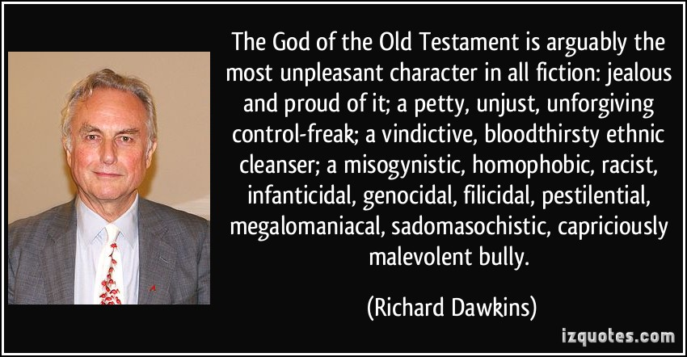
Critics
“The God of the Old Testament is arguably the most unpleasant character in all fiction: jealous and proud of it; a petty, unjust, unforgiving control-freak; a vindictive, bloodthirsty ethnic cleanser; a misogynistic, homophobic, racist, infanticidal, genocidal, filicidal, pestilential, megalomaniacal, sadomasochistic, capriciously malevolent bully.”
—Richard Dawkins
Notes:
Maybe he’s listened to Richard Dawkins, who wrote…

Slide 6
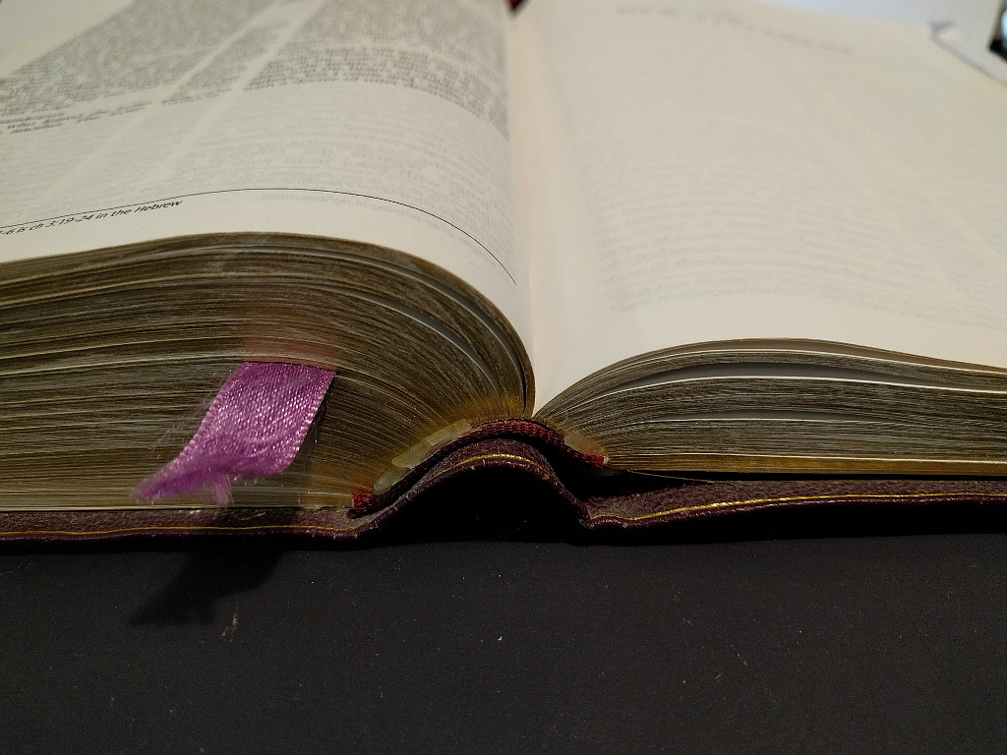
What do you do with the Old Testament?
Notes:
Are you like many Christians who promise to read through the OT at the beginning of the year but by February you bog down in Leviticus…

Slide 7
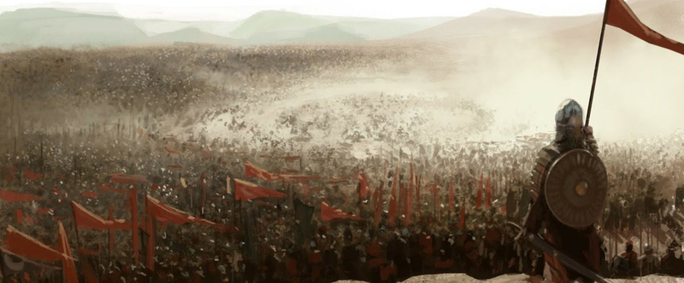
Slaughter of the Canaanites
Notes:
…or even hit the slaughter of the Canaanites and quit?

Slide 8
Slavery in the Old Testament
Notes:
Some see it as condoning slavery too.

Slide 9
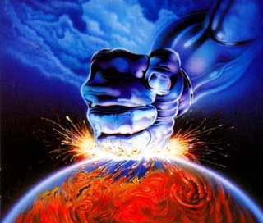
The Supposed Old Testament God
Notes:
I once interviewed a candidate for elder and he said that he hadn’t read the whole Bible yet—the prophets always tripped him up because they depicted a fiery God.

Slide 10
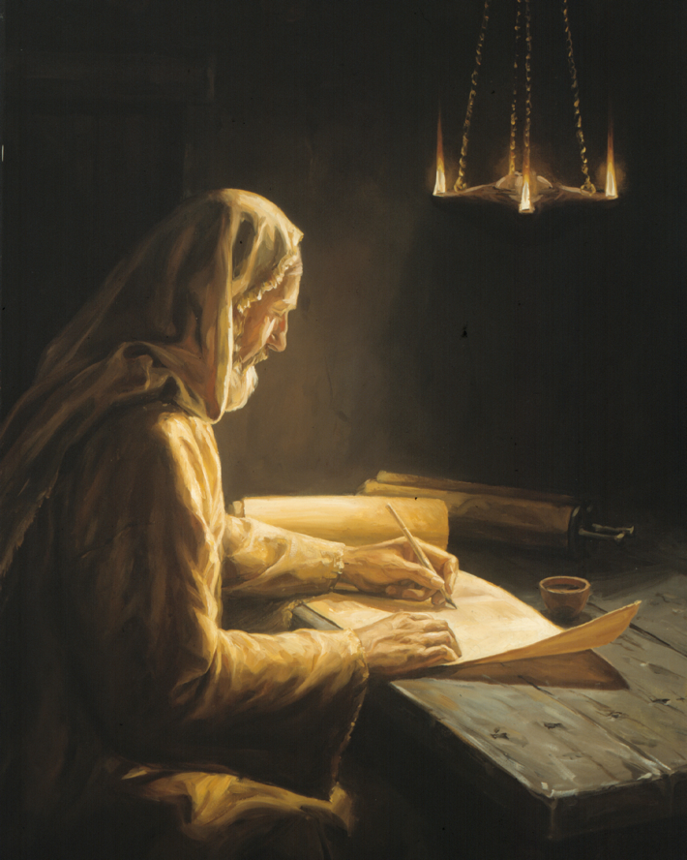
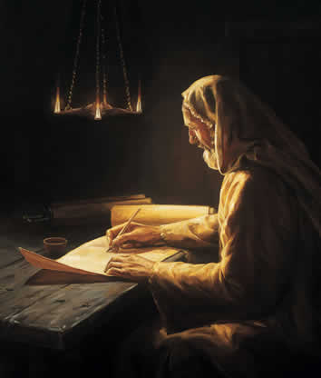
Two Different Testaments
Notes:
What’s your attitude about plugging through stories you don’t understand—or worse, the… (oh, my!) genealogies!

Slide 11
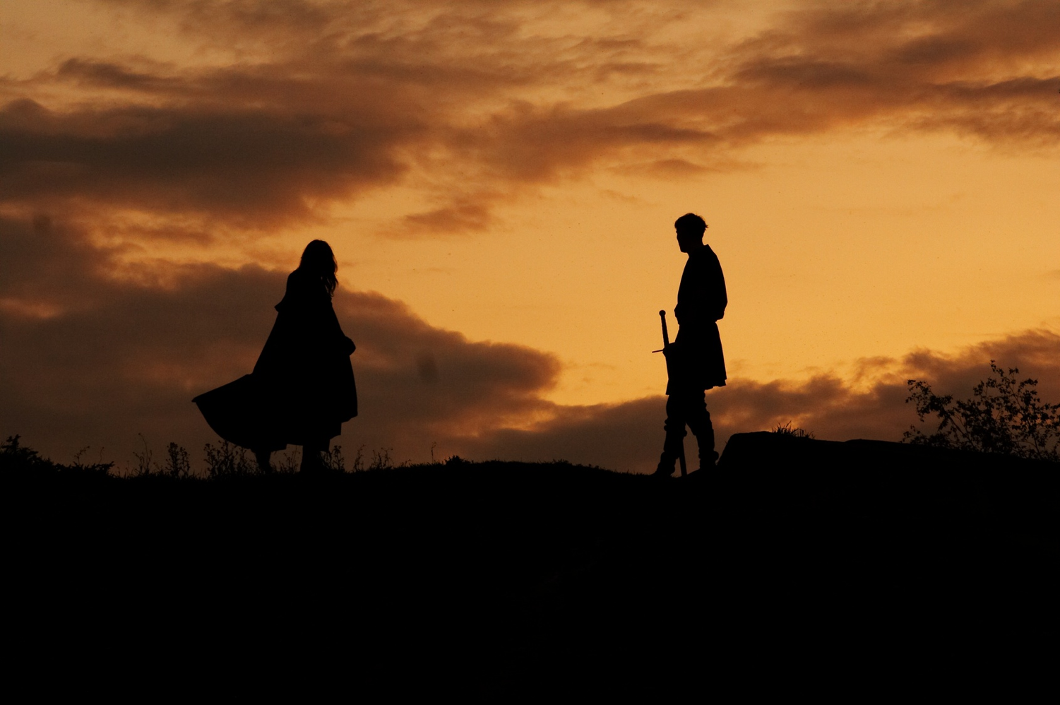
How should we relate to the Old Testament?
Notes:
What is the proper Christians response to this first 3/4ths of the Bible?

Slide 12
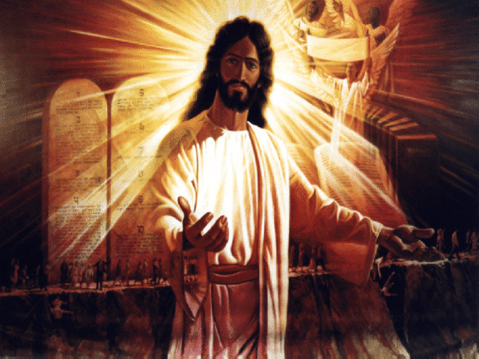
Jesus & the OT
Notes:
The OT was highly regarded in Jesus’ time, but early believers in Christ didn’t know how his coming changed things.

Slide 13
Why was the Law so vital?
The Law gave Israel a governmental charter
Notes:
God graciously established the Law with Israel at Mount Sinai. It was the governing charter with the nation and was far superior to any law code of the surrounding nations

Slide 14
The Mosaic Law
Atonement
Equity
From God himself
Relationship
Love
Notes:
God graciously established the Law with Israel at Mount Sinai. It was the governing charter with the nation and was far superior to any law code of the surrounding nations.
1. The Law dealt with sin by providing a system of atonement instead of just appeasing the deity like the pagans.
2. The Law treated all classes of society the same, unlike the Code of Hammurabi that favored the rich.
3. The Law was given from the hand of God himself rather than simply being invented by sinful man.
4. The Law established a relationship with the Jewish people uniquely in the Mid-East.
5. No wonder that King David said, "Oh, how I love your Law"!

Slide 15
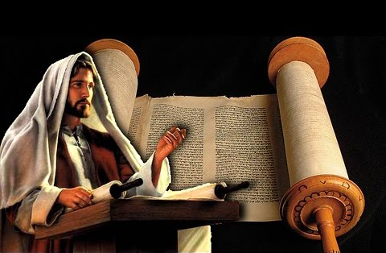
Jesus & the OT
Notes:
NT Jews so adored the OT that they could never conceive of anything better. They needed to see that, better than the Law, was the Lawgiver himself!
But Christ's teaching brought some confusion.
Jews of Christ's day, as well as us today, need to know how Jesus relates to the OT law.
Does he just add to it? Does he replace it?

Slide 16
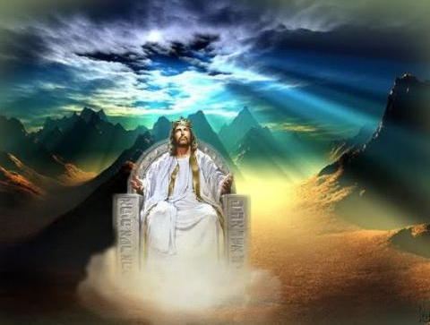
When Jesus is King… (Matthew 5–7)
What would your life look like if Christ was truly the boss of your life?
Notes:
The Sermon on the Mount (Matt 5–7) show what it looks like when someone has changed his thinking about Christ—the "fruits" of repentance.

Slide 17
How to be blessed (1-12)
How to be a blessing (13-16)
Website
Notes:
Now that Christ had shared how to be blessed (5:1-12), we see the flip side of this: how to be a blessing to others.
• Some consider verses 13-16 a continuation of the Beatitudes since they still speak of the nature of those who know Christ—the attitudes and character they should show.

Slide 18
Direct others to God.
Main Idea of Matthew 5:13-16
Notes:
Influence people to follow God (MI restated).
Impact others for good (MI restated).
Show people God (MI restated).

Slide 19
Key Truths Today:
(1) How long the OT is useful (2) How this relates to us

Slide 20
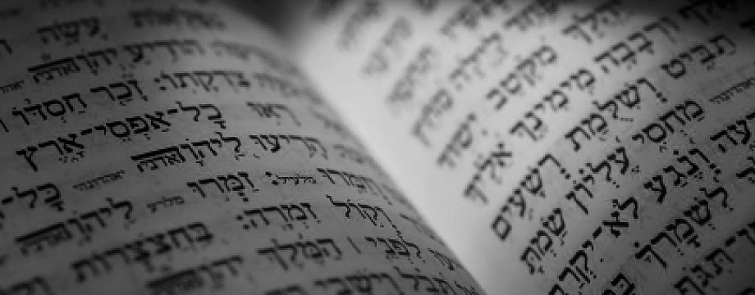
The Proper Way to View the Old Testament
Matthew 5:17-20

Slide 21
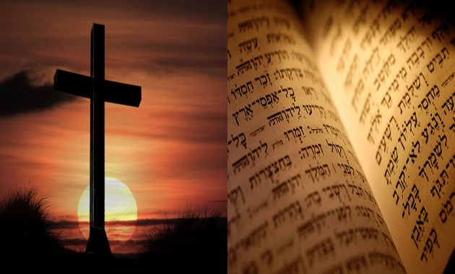
I. The OT will remain until all it prophesies about Jesus comes true (5:17-18).
Notes:
Many OT predictions about Christ must happen before the OT is obsolete

Slide 22
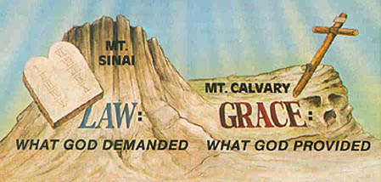
Jesus came to fulfill the OT rather than abolish it (5:17)
MT. SINAI
MT. CALVARY
LAW
GRACE
WHAT GOD DEMANDED
WHAT GOD PROVIDED

Slide 23
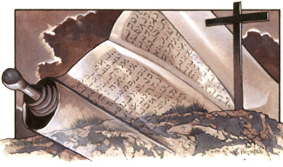
"Do not think that I have come to abolish the Law or the Prophets; I have not come to abolish them but to fulfill them" (5:17 NIV).
Notes:
Did the people listening to Jesus’ preaching think that he was throwing out the OT (17a)?

Slide 24
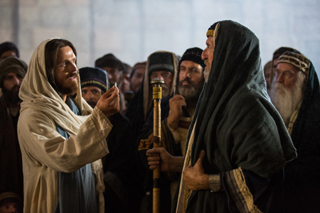
Jesus confronted the Pharisees
Notes:
Jesus disregarded the oral traditions of the Pharisees, which they considered equal to the OT. He didn't exactly please them on hand washing, fasting weekly, and associating with "unclean" people, so they falsely accused him of disobeying God.
Instead, Jesus taught on his own authority instead of citing the various rabbis.
When Jesus declared to be "Lord of the Sabbath" he was misunderstood as thinking that they didn't have to obey the Sabbath.
Jesus was accused of ignoring the OT Law in many instances when he was only getting the people back to its real intent.
For example, the real issue was not whether people followed all the Sabbath rules of the Pharisees, but whether they rested and related to God and man.

Slide 25
"Do not think that I have come to abolish the Law or the Prophets; I have not come to abolish them but to fulfill them" (5:17 NIV).
Notes:
Why does Jesus mention “the Law or the Prophets” (17b)?

Slide 26
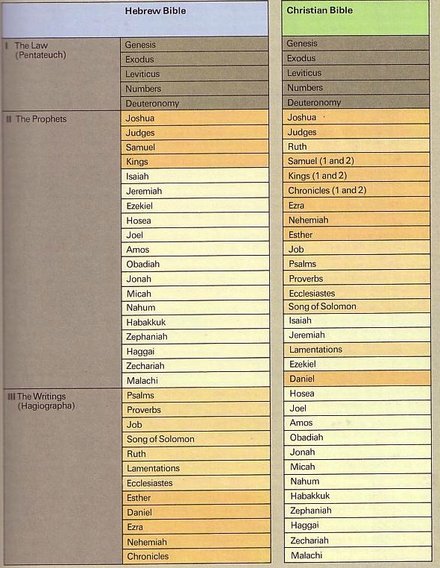
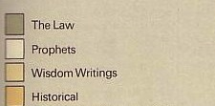
The Hebrew Canon
193
The Hebrew Canon
Jewish and Christian books are the same but in different order and classification
Notes:
We have the same OT books but a different order

Slide 27
The Hebrew Canon
193
The Hebrew Canon
?
Matthew 5:17 "Do not think that I have come to abolish the Law or the Prophets;
I have not come to abolish them but to fulfill them."
Jewish and Christian books are the same but in different order and classification
Notes:
The Hebrew OT is divided into three sections: Law, Prophets, and Writings

Slide 28
The Hebrew Canon
193
The Hebrew Canon
Luke 24:44 "… everything written about me in the Law of Moses and the Prophets and the Psalms must be fulfilled."
Jewish and Christian books are the same but in different order and classification
Notes:
Christ elsewhere mentions the Psalms too, probably giving this first book of the Writings division as representative of the whole section.
Jesus is in all probability referring to the entire OT as sometimes “Law” itself refers to the whole OT.

Slide 29
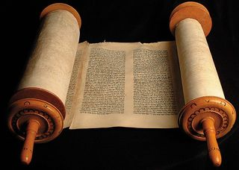
The Christian's Relationship to the Law
112
Notes:
Was the Pentateuch divided into parts, some of which we should still obey and others that don’t apply today?

Slide 30
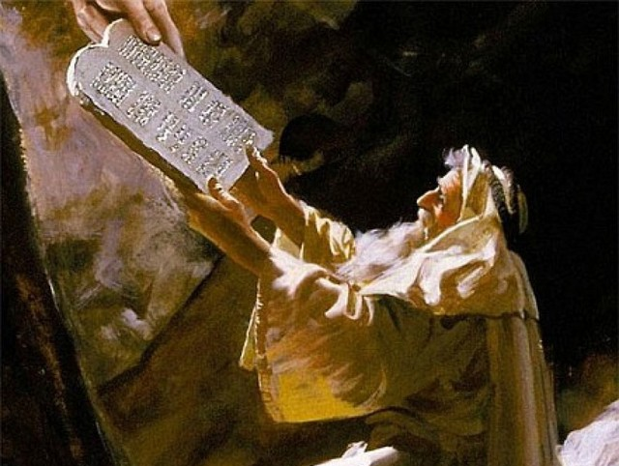
The heart of the Mosaic Covenant is the Ten Commandments
Notes:
This is a common approach: moral laws apply (esp. the Ten Commandments), but we don’t have to worry about civil or ceremonial laws today

Slide 31
TRADITIONAL VIEW ON LAW
Ex. 25-31
104
7
A Godly Education In Three Parts:
MORAL: The Ten Commandments; a basis for our current legal system.
CIVIL: How the people are to live with each other in the new social structure.
CEREMONIAL: How to worship God in the new social structure.
BUT ARE THE BIG 10 MORAL LAW?
MOSES
Exodus
Sinai
M - C - C
40
Handbook pg. 26-29
13
Notes:
This is a common approach: moral laws apply (esp. the Ten Commandments), but we don’t have to worry about civil or ceremonial laws today

Slide 32
Moral law means God's rules that apply to…
Every time period
Every culture
Every place
Every people

Slide 33
The Ten Commandments
113a
#
Old Testament Commands
New Testament Repetitions
1
And God spoke all these words: "I am the LORD your God, who brought you out of Egypt, out of the land of slavery. You shall have no other gods before me" (Exod. 20:1-3).
"Men, why are you doing this? We too are only men, human like you. We are bringing you good news, telling you to turn from these worthless things to the living God…" (Acts 14:15; noted 50+ times).
2
"You shall not make for yourself an idol… of anything in heaven above or on the earth beneath or in the waters below… for I… am a jealous God, punishing the children for the sin of the fathers … but showing love to a thousand generations of those who love me…" (Exod. 20:4-6).
"Dear children, keep yourselves from idols" (1 John 5:21; cf. 1 Thess. 1:9; Rev. 2:14, 20; 9:20; mentioned in the NT 12 times = 12x).
* This chart is adapted and expanded from one by Lewis Sperry Chafer, Systematic Theology, 4:209-10
3
"You shall not misuse the name of the LORD your God, for the LORD will not hold anyone guiltless who misuses his name" (Exod. 20:7).
"Above all…do not swear–not by heaven or by earth or by anything else. Let your 'Yes' be yes, and your 'No,' no, or you will be condemned" (James 5:12; 4x).

Slide 34
The Ten Commandments
113a
#
Old Testament Commands
New Testament Repetitions
4
"Remember the Sabbath day by keeping it holy. Six days you shall labor and do all your work, but the seventh day is a Sabbath to the LORD your God. On it you shall not do any work… nor your son or daughter, nor your manservant or maidservant, nor your animals, nor the alien within your gates. For in six days the LORD made the heavens and the earth… but he rested on the seventh day…" (Exod. 20:8-11).
No NT text requires this of Christians.
However, one passage clearly prohibits the practice as required for believers: "Therefore do not let anyone judge you by what you eat or drink, or with regard to a religious festival, a New Moon celebration or a Sabbath day. These are a shadow of the things that were to come; the reality, however, is found in Christ" (Col. 2:16-17; 0x).
5
"Honor your father and your mother, so that you may live long in the land the LORD your God is giving you" (Exod. 20:12).
"Children, obey your parents in the Lord, for this is right. 'Honor your father and mother'–which is the first commandment with a promise–that it may go well with you and that you may enjoy long life on the earth" (Eph. 6:1-3; Matt. 15:4-6; 19:19; Mark 7:10; 10:19; 6x).
6
"You shall not murder" (Exod. 20:13).
"Anyone who hates his brother is a murderer, and you know that no murderer has eternal life in him" (1 John 3:15; cf. Matt. 19:18; Mark 10:19; Luke 18:20; Rom. 13:9; James 2:11; 6x).

Slide 35
The Ten Commandments
113a
#
Old Testament Commands
New Testament Repetitions
7
"You shall not commit adultery" (Exod. 20:14).
"Marriage should be honored by all, and the marriage bed kept pure, for God will judge the adulterer and all the sexually immoral" (Heb. 13:4; cf. Mark 10:19; 12x).
8
"You shall not steal" (Exod. 20:15).
"He who has been stealing must steal no longer, but must work, doing something useful with his own hands…" (Eph. 4:28; cf. Matt. 27:64; Mark 10:19; Luke 18:20; Rom. 13:9; Titus 2:10; 6x).
9
"You shall not give false testimony against your neighbor" (Exod. 20:16).
"Do not lie to each other, since you have taken off your old self with its practices" (Col. 3:9; cf. Eph. 4:25; 4x).
10
"You shall not covet your neighbor's house… wife, or his manservant or maidservant, his ox or donkey, or anything that belongs to your neighbor" (Exod. 20:17).
"'Watch out! Be on your guard against all kinds of greed; a man's life does not consist in the abundance of his possessions'" (Luke 12:15; Rom. 7:7; 13:9; Eph. 5:3; James 4:2; 2 Pet. 2:3, 14; 9x).

Slide 36
Does the Law of Moses Apply to Me? (Five Views)
Spectrum on Degree of Applicability:
Theonomic Greg Bahnsen | Reformed Willem VanGemeren | Weightier Issues Walter Kaiser | Modified Lutheran Douglas Moo | Dispensational Wayne G. Strickland
Law as fully applicable in every sense
Law as fully abolished in every sense
This chart summarizes Stanley N. Gundry, ed. Five Views on Law and Gospel (Grand Rapids: Zondervan, 1996), where each author presents his view and responds to the other four views. Generally speaking, views 1-2 are similar as both are Reformed (stressing continuity between the NT and OT) and these stand against views 3-5 which alike stress discontinuity. In my opinion, the dispensational view has the most to commend it as law in the NT is never broken into component parts and this view clearly distinguishes Israel from the church. Further, it is inconsistent to change the Sabbath (Saturday) to Sunday but not apply the OT penalties for Sabbath-breaking today (i.e., death by stoning; cf. Exod. 31:14-15; 35:2). The following chart is adapted from Lee Hwee Chin, "The Applicability of the Law Today," unpublished research paper for the course "Old Testament Survey," Singapore: Singapore Bible College, 2001), 1.
Notes:
There’re actually at least five major approaches to how Christians relate to the Old Testament

Slide 37
Was the Law ever required of Gentiles—such as the Sabbath?
Notes:
Many teachers maintain that the law has abiding validity.
Berkhof writes, "The law is a rule of life for believers, reminding them of their duties and leading them in the way of life and salvation."
Strong agrees: "Christ does not free us from the law as a rule of life."
Allis also notes, "The law is a declaration of the will of God for man's salvation."
Likewise, many other scholars also teach that the Law continues into the present age or that Paul was confused regarding the law's function.

Slide 38
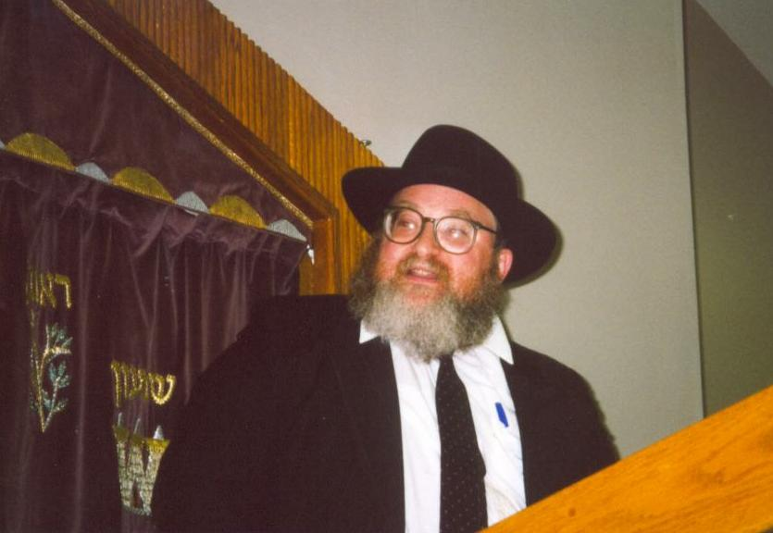
To Clip or Not to Clip?
Lev. 19:27– "Do not cut the hair at the sides of your head or clip off the edges of your beard."

Slide 39
What do you think?
Are we living under law?
Can I eat pork?
Should I obey the Sabbath?
LAW
Can Christians eat blood (e.g., yong tau foo, blood pudding)?
How does the Law relate to us?
Does God require me to tithe?

Slide 40
Leviticus 19:28 "Do not cut your bodies for the dead, and do not mark your skin with tattoos. I am the LORD."
Notes:
Can Christians today have tattoos even though they are prohibited by the OT Law?
What if they are tattoos about Jesus?!

Slide 41
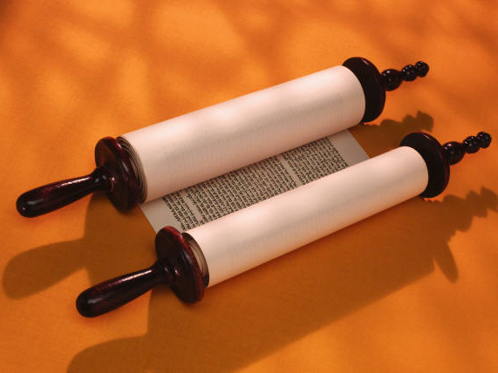
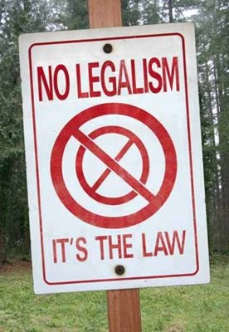
No Legalism!
"So don't let anyone condemn you for what you eat or drink, or for not celebrating certain holy days or new moon ceremonies or Sabbaths. ¹⁷For these rules are only shadows of the reality yet to come. And Christ himself is that reality" (Col. 2:16-17 NLT)

Slide 42
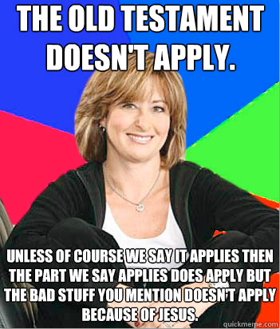
The Old Testament Doesn’t Apply
Unless of course we say it applies then the part we say applies does apply but the bad stuff you mention doesn’t apply because of Jesus
Notes:
https://www.reddit.com/r/atheism/comments/10ghp5/the_old_testament_doesnt_apply_unless/

Slide 43
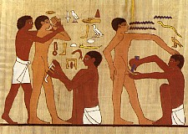
"So Christ has truly set us free. Now make sure that you stay free, and don't get tied up again in slavery to the law" (Gal. 5:1 NLT).
"Listen! I, Paul, tell you this: If you are counting on circumcision to make you right with God, then Christ will be of no benefit to you. ³I'll say it again. If you are trying to find favor with God by being circumcised, you must obey every regulation in the whole law of Moses. ⁴For if you are trying to make yourselves right with God by keeping the law, you have been cut off from Christ! You have fallen away from God's grace" (5:2-4 NLT).
Notes:
Paul's saw the law as a whole. His point is that if one is required to keep any part of it, he is obligated to keep all of it.

Slide 44
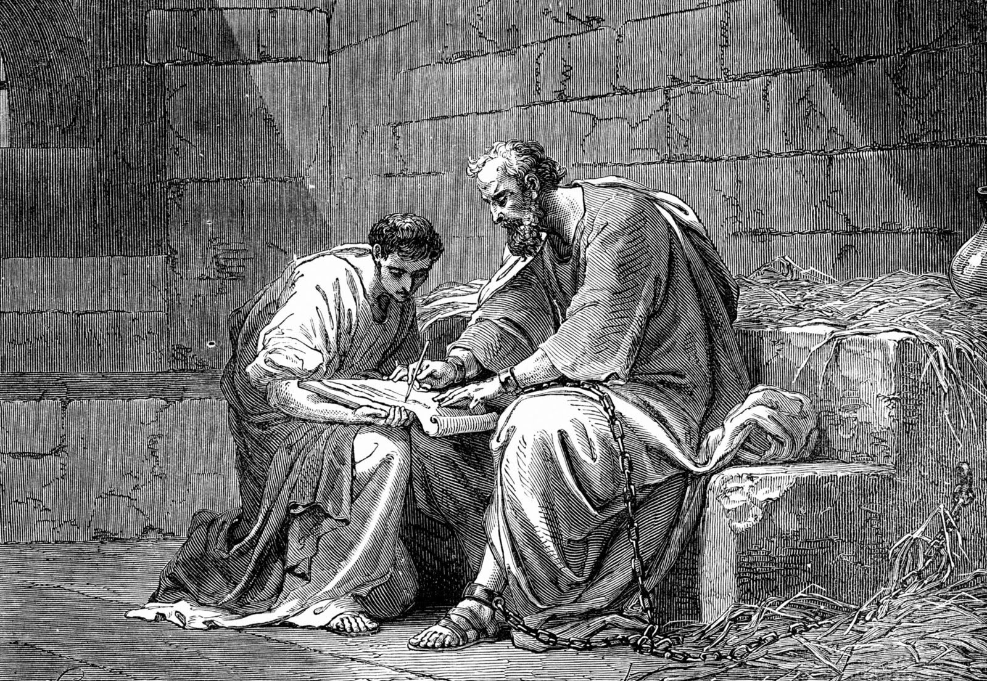
Paul gave up rights to help Jews, Gentiles and weak Christians mature in Christ (1 Cor 9:19-23)
All (19)
Jews (20)
Gentiles (21)
Weak (22a)
Motive (22b-23)
Notes:
“To the Jews I became like a Jew, to win the Jews. To those under the law I became like one under the law (though I myself am not under the law), so as to win those under the law” (1 Cor. 9:20).

Slide 45
"I tell you the truth, until heaven and earth disappear, not the smallest letter, not the least stroke of a pen, will by any means disappear from the Law until everything is accomplished" (5:18 NIV).
Notes:
The OT won’t disappear until creation disappears when every prophecy about Christ is fulfilled (5:18).

Slide 46
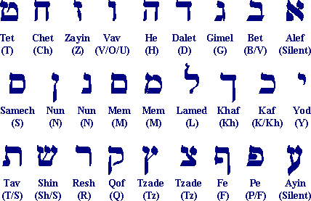
The Hebrew Consonants
The Hebrew Consonants
"tittle"
"yod"
Matt. 5:18 "… For verily I say unto you, Till heaven and earth pass, one jot or one tittle shall in no wise pass from the law, till all be fulfilled" (KJV).
Matt. 5:18 "… For truly I say to you, until heaven and earth pass away, not the smallest letter ["yod" or "jot"] or stroke ["tittle"] shall pass from the Law until all is accomplished" (NASB).
http://www.keyway.ca/htm2002/hebrewal.htm
Notes:
“Jesus’ fulfillment would extend to the smallest Hebrew letter, the ‘jot’ (lit., dwøy), and even to the smallest stroke of a Hebrew letter, the ‘tittle.’ In English a jot would correspond to the dot above the letter ‘i’ (and look like an apostrophe), and a tittle would be seen in the difference between a ‘P’ and an ‘R’. The small angled line that completes the ‘R’ is like a tittle. These things are important because letters make up words and even a slight change in a letter might change the meaning of a word.”
“Jesus said He would fulfill the Law by obeying it perfectly and would fulfill the prophets’ predictions of the Messiah and His kingdom.”

Slide 47
How should we relate to the Old Testament?
Notes:
So the OT is very relevant, even though we aren’t under the Mosaic Law.

Slide 48
I. The OT will remain until all it prophesies about Jesus comes true (5:17-18).
Notes:
In light of its continuing relevance, how will God hold us accountable for how we respond to the OT? Well…

Slide 49
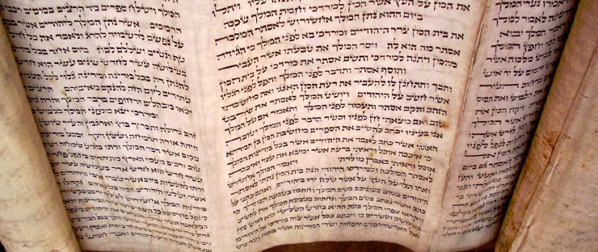
II. We'll be rewarded based on our response to the OT (5:19-20).

Slide 50
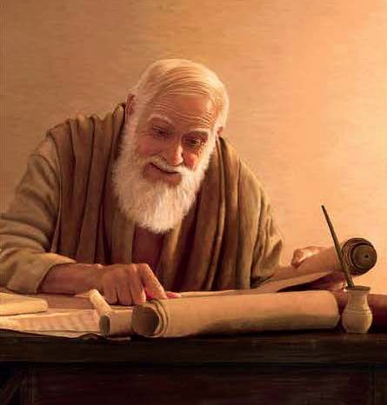
"Anyone who breaks one of the least of these commandments and teaches others to do the same will be called least in the kingdom of heaven, but whoever practices and teaches these commands will be called great in the kingdom of heaven" (5:19 NIV).
Notes:
Our millennial rewards depend on practicing and teaching the true spirit of OT (5:19).
What are "the least of these commandments" (19a)?
"The Jews had graded the commandments according to what they thought were the most important (Matthew 22:36)."
For the sake of argument, Jesus tells them that even the so-called "least" command was important to obey and teach.
______
M'Neile, St. Matthew, 59; cited by Toussaint, 100.

Slide 51
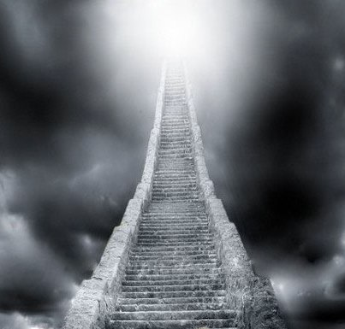
Rewards in the Kingdom of Heaven
Notes:
How is it that a violator of the Law is “least in the kingdom of heaven” (19b)? Does this mean a person is saved by whether they obey the Law?
This depends on what is meant by “the kingdom of heaven” in Matthew. We have seen that it refers to being under Christ’s rule—especially when he is King over the earth after his return.
So how is a person least in the Millennium? He has trusted Christ for salvation but has little works for Christ to show for it.

Slide 52
"Scripture" (5: NLT).
Notes:
How can the one who practices and teaches Christ’s commands “be called greatest in the kingdom of heaven” (19c)? Does this mean his works save him—or does it mean that he has a greater reward in heaven?
This text shows us that Jesus is connected to the OT law in that he fulfills it. Therefore, the Law is not abolished as it is really helpful today, but better than following the Law, we practice the Law by trusting Christ and teaching others to do the same

Slide 53
Entering the Kingdom of Heaven
Notes:
We'll enter the millennium not by external piety like the Pharisees but through Christ (5:20).

Slide 54
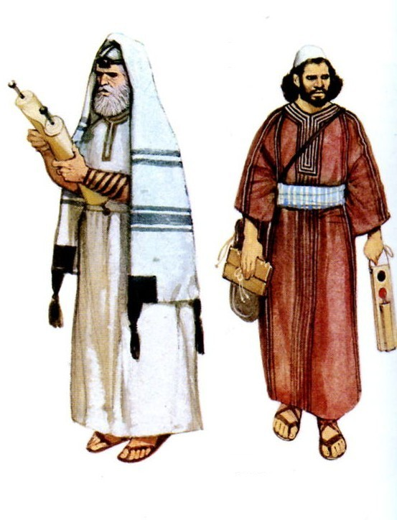
"For I tell you that unless your righteousness surpasses that of the Pharisees and the teachers of the law, you will certainly not enter the kingdom of heaven" (5:20 NIV).
Notes:
How would the Pharisees and Scribes be the standard for entering “the kingdom of heaven” (20)? How can one be better than them?

Slide 55
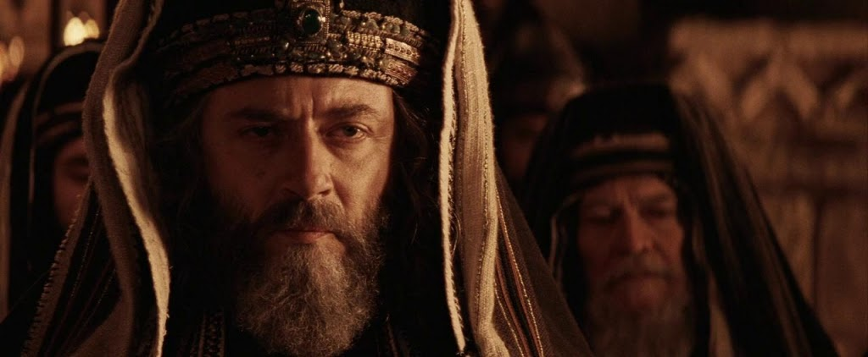
"The Epitome of Righteousness"
Notes:
These leaders were the epitome of righteousness in the time of Christ—so who would be better than them?
This seemed impossible—until one asked about the kind of righteousness these leaders had. Of course, it was only an external righteousness.

Slide 56
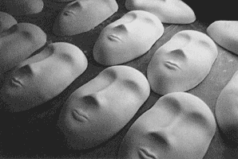
External Righteousness
Notes:
No one followed their rules better than them.
They fasted twice weekly, they even tithed their spices harvested, the never walked farther than the tradition said to walk on the Sabbath.

Slide 57
"Torah observant" but missing the point

Slide 58
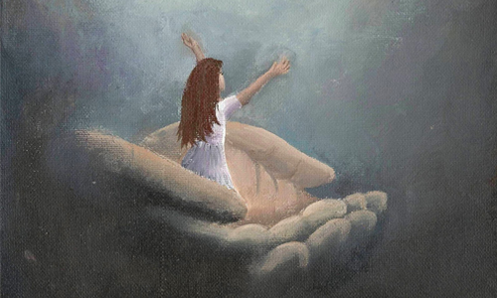
Righteous in Christ
Notes:
Yet Jesus expected a different kind of righteousness—an internal purity that came from simple trust in Christ.
As we will see in the coming weeks, Jesus rejected the traditions of the Pharisees (5:21-48) and their practices (6:1-7:6).
Instead, he offered himself as the way to righteousness. What a relief!

Slide 59
"For I tell you that unless your righteousness surpasses that of the Pharisees and the teachers of the law, you will certainly not enter the kingdom of heaven" (5:20 NIV).
Notes:
Was Jesus saying that the Pharisees and teachers of the law would not be saved (20)?
That is exactly what he was saying.
I say this because if we are only as righteous as they are we won’t enter the kingdom of heaven. In other words, we have to be more righteous then these Jewish leaders.
And how can we be more righteous than the Pharisees (20)?
Jesus doesn’t tell us here! “Verse 20 does not establish how the righteousness is to be gained, developed, or empowered; it simply lays out the demand.”
Believe in the One whom they rejected—the only One who can make us righteous inside.
D. A. Carson, “Matthew, EBC, 8:147.

Slide 60
How should we relate to the Old Testament?

Slide 61
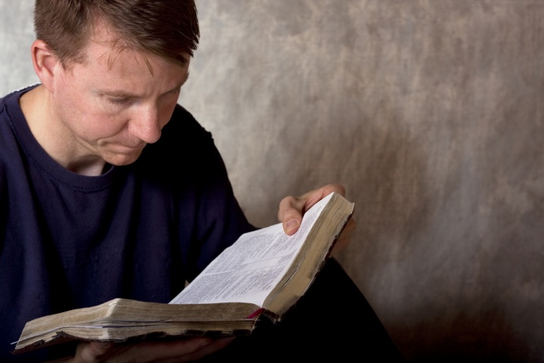
Read the OT but focus on Jesus
Main Idea of 5:17-20

Slide 62
I. The OT will remain until all it prophesies about Jesus comes true (5:17-18).
Notes:
So the OT is very relevant, even though we aren't under the Mosaic Law. In light of its continuing relevance, how will God hold us accountable for how we respond to the OT? Well…

Slide 63
II. We'll be rewarded based on our response to the OT (5:19-20).

Slide 64
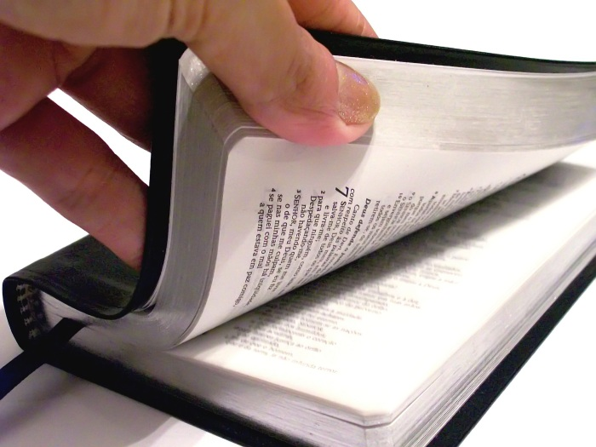
How much do you read the OT?

Slide 65
NT Sermons link at BibleStudyDownloads.org
Get this presentation and script for free!
Notes:
Download my OT Survey notes to help!

Slide 66
Black

